Slide 1
Coding to the Stars: The Technical Backbone of Project Flare

Slide 2

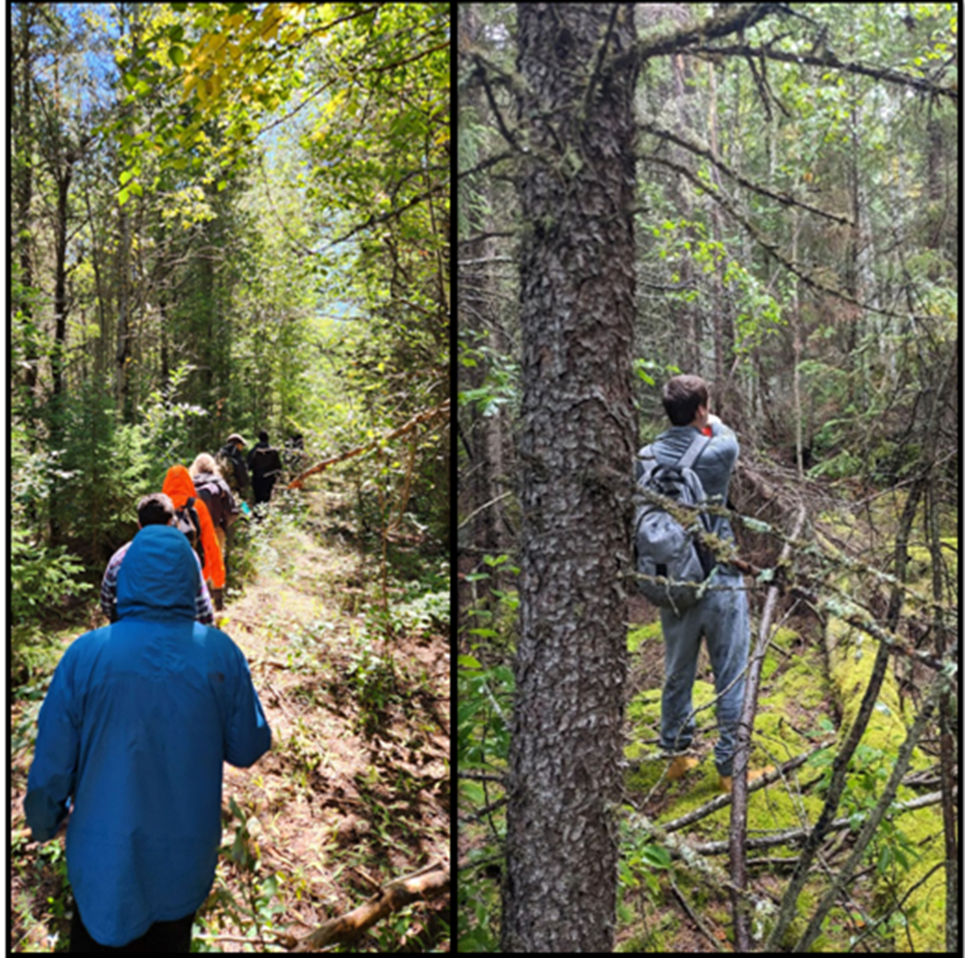
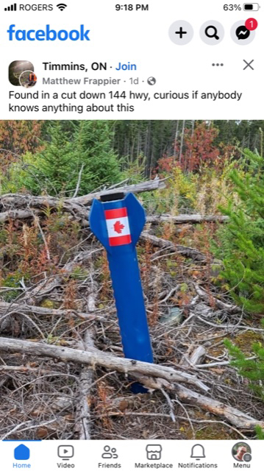
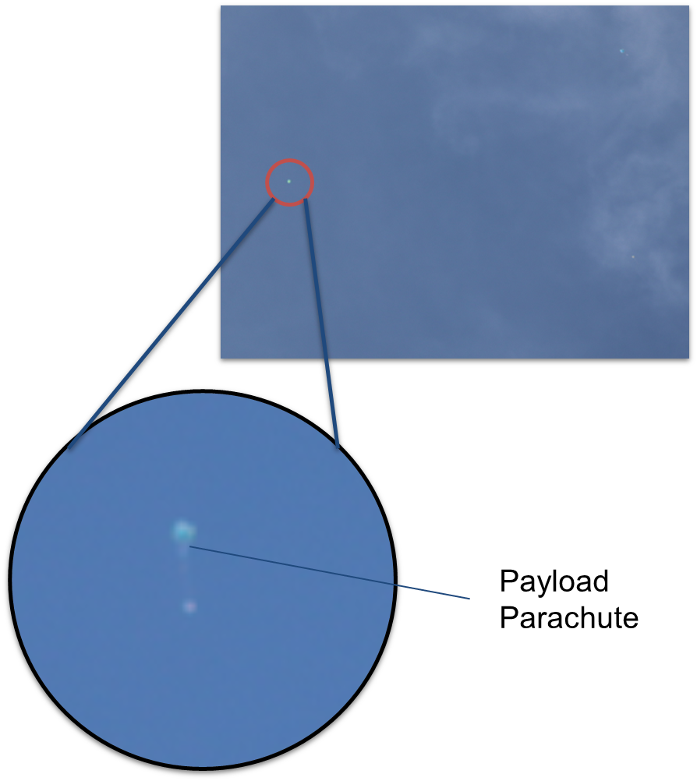
WHY DO WE NEED THIS FLARE 1.0?
“FLARE” Flight Launch Analysis and Recovery Estimator
OTMK1 was lost in the forest last year due to many factors
1. Due to competition timing
Rocket recovery was not possible on the same day
GPS Batteries last for 12 Hrs MAX
GPS Trackers lost signal at 500 m above sea level.
2. Poor rocket tracking
Could not obtain rockets position during and after flight
No active telemetry
Hard Crash Landing Far away from the launch Site 😭
More Possible Reasons for Loss
3. Shear Pin Failure (Black Powder Size Overestimation)
4. GPS Signals lost past Tree-line (No reception)
5. GPS Battery Capacity
Batteries last for 12hrs MAX (Should last 24hrs Minimum)
6. Poor radio reception, rocket went invisible for a period of time.
Efficient implementation of FLARE 1.0 will tackle and solve all issues
Main Chute Opened at Apogee (11,000ft) 😭, however, it was meant to open at 800ft
Parachute was colored green 😭, but guess what? The grass was also colored green

Slide 3
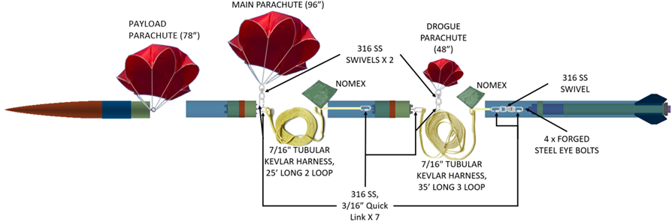
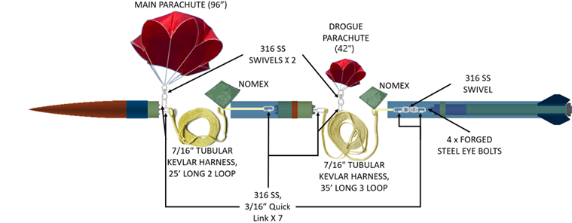
OTMKI
Other differences
OTMKII has a shorter overall length
OTMKII is aiming to go higher
1” Smaller in Diameter
OTMKII has only two (2) parachutes
Drogue & Main
MAIN DIFFERENCE: OTMKII HAS NO PAYLOAD PARACHUTE
OTMKII

Slide 4
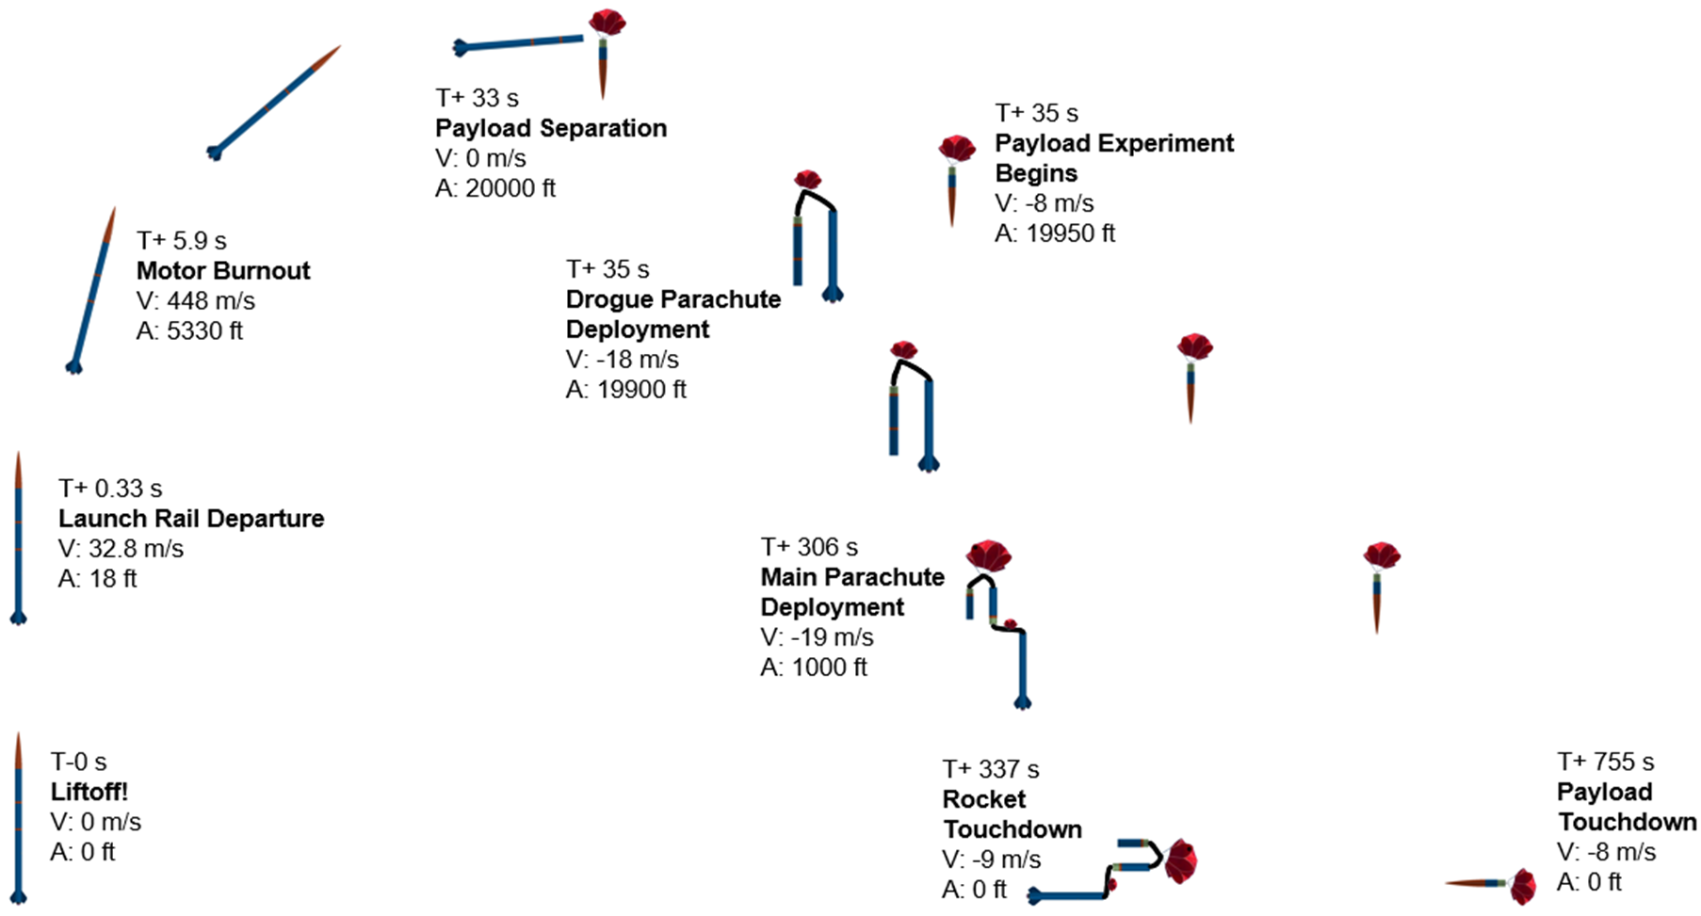
OTMKI
Above this line, the rocket went invincible due to low transmitter radio range
Below this line, rocket went invincible due to falling below the trees

Slide 5
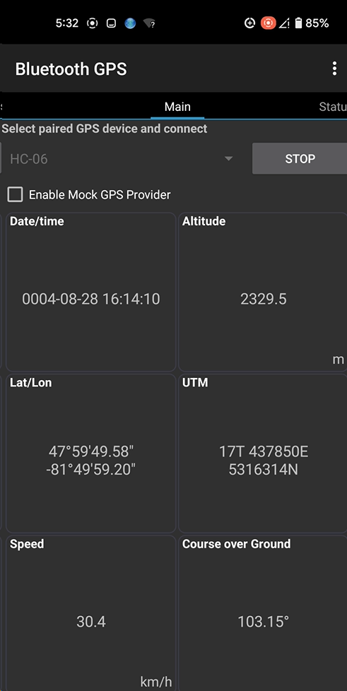
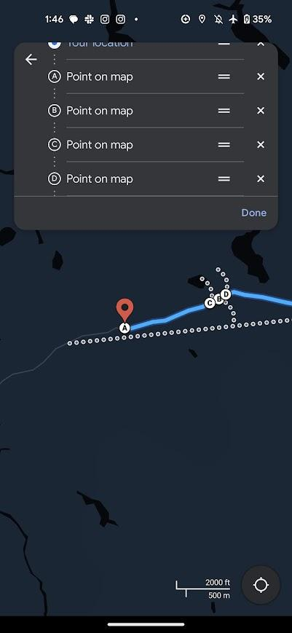
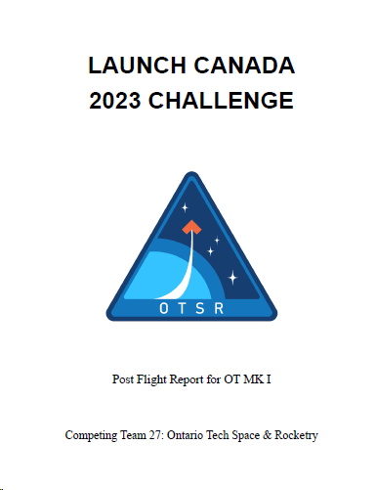
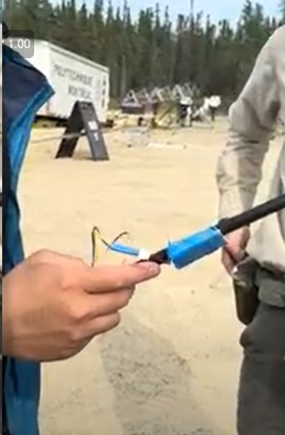
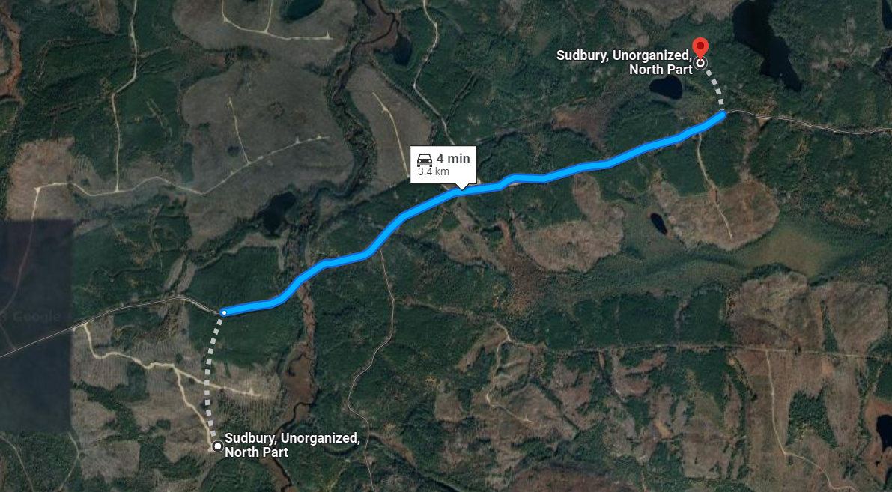
OTMK1 LESSONS LEARNED
Review this document: G:\Shared drives\Ontario Tech Rocketry\2022-2023 Ontario Tech Space and Rocketry\Departments\Launch Canada\2023-13-10 OTSR Post Flight Report.pdf
Telemetry Last Year
Was a complete joke😭
Could fit in one man's right pocket
ZERO obtainable CSV format
Rocket GPS data was bouncing from place to place (Showed the rocket was in China, then Nigeria at some point)
Data should be filtered
The rocket data was screen recorded using an android phone application:
Imagine spending hours scrubbing through this video in an off-road moving truck, typing into a dying computer on google maps while trying to filter the “potential” rocket coordinates by shaking eyes.

Slide 6
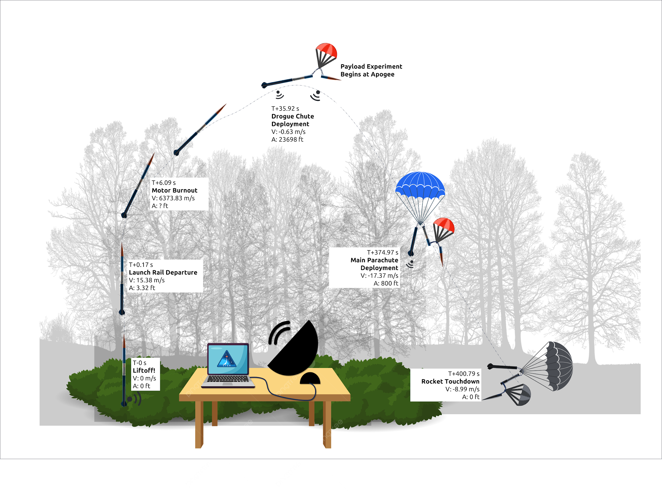
OTMKII
Rocket MAY become invisible near apogee
Predict OTMKIIs position without use of live telemetry data
Rocket WILL be invisible below tree line
Predict possible crash site with last received telemetry packets from OTMKII

Slide 7

PRE-FLIGHT
DURING FLIGHT
POST FLIGHT
Rocket in Flight
T+x seconds
(Rockets polling rate)
Verify Launch Angle, Latitude, Longitude & Altitude
Obtain Predicted Crash Site
Rocket Transmits data
Position data
(Longitude & Latitude)
Orientation Data
(Euler Angles)
Measure Wind Speeds and Directions
Re-run Open rocket Simulation
FLARE 1.0
Data from the rocket comes as .csv file
EXCEL
MATLAB
Continually import data into MATLAB
Update Launch Canada Launch Card with newly projected altitude to gain more points PRIOR TO LAUNCH.
PROVIDE POSSIBLE COORDINATES IN RADIAL REGIONS BASED ON CONFIDENCE LEVELS/INTERVALS
Output Rockets Predicted Position @T+x + 2s
(Long + Latitude)

Slide 8
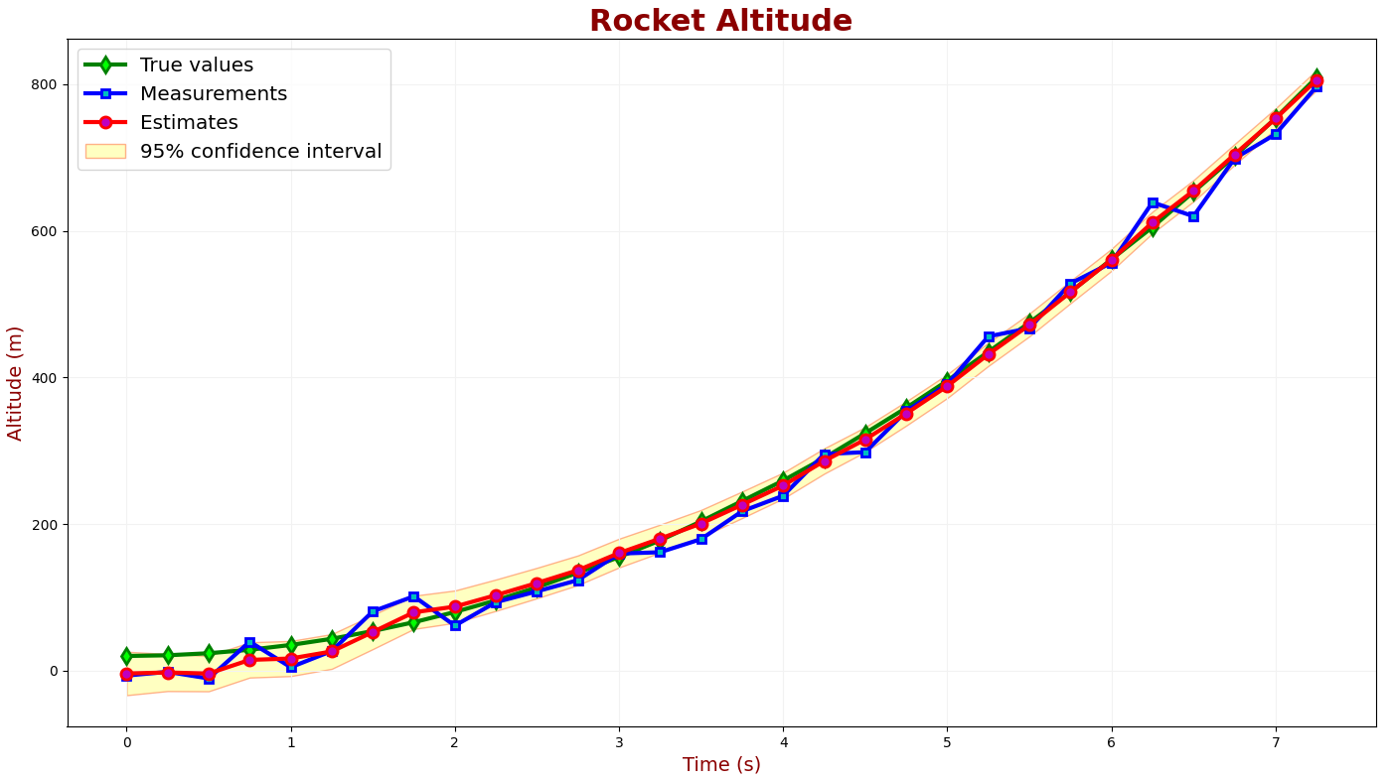
TESTING PLAN
Using the inbuilt kinematic solver developed (FLARE 1.0), collaborate with Avionics
Utilize tab delimitated spacing for storing data from the rocket (Avionics-Telemetry is responsible)
Date | Time (s) | Longitude | Latitude | Altitude (m)
Sunday December 24 | 0 | 47°59’12.97” | -81°50’54.05” | 200
. | . | . | . | .
Make this data meaningful (Recovery is responsible)
Import CSV into MATLAB
Engineering Validation testing can be conducted by utilizing a GPS Coordinate recorder on a phone application
The user can simply throw their phone carefully from one point of a room to another over well cushioned ground OR
Recovery should collaborate with Avionics and use the purchased flight computer which houses a GPS. Keep in mind however, due to timing – It will be faster and more beneficial to get started with whatever option is most readily available.
Recovery is responsible for developing test methods to validate the use of FLARE and make it bug proof
Software Tester: Someone needs to develop a PYTHON script that writes to a notepad document at the rockets avionics poll rate to simulate the rocket as if it is transmitting data in real life.
Script should be able to write data at a specified polling rate
Allow user to specify invincibility regions based on altitude
Read data should be based on a real world measured data from a rocket flight

Slide 9
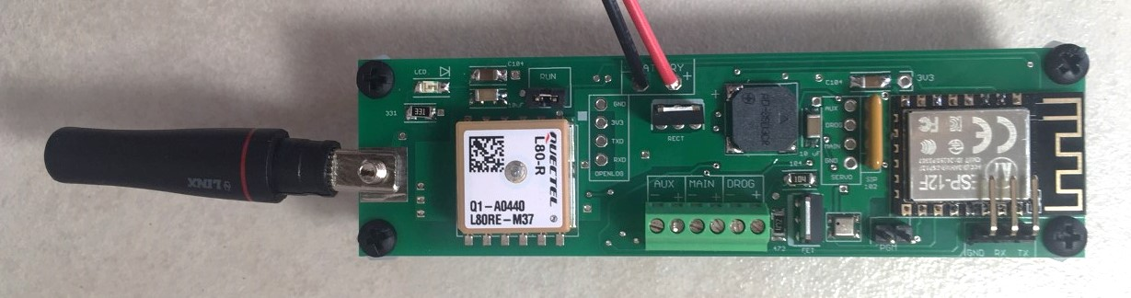
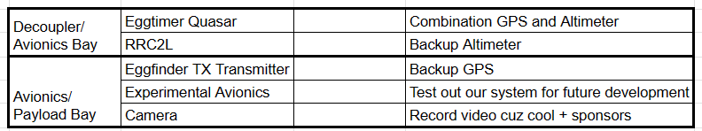
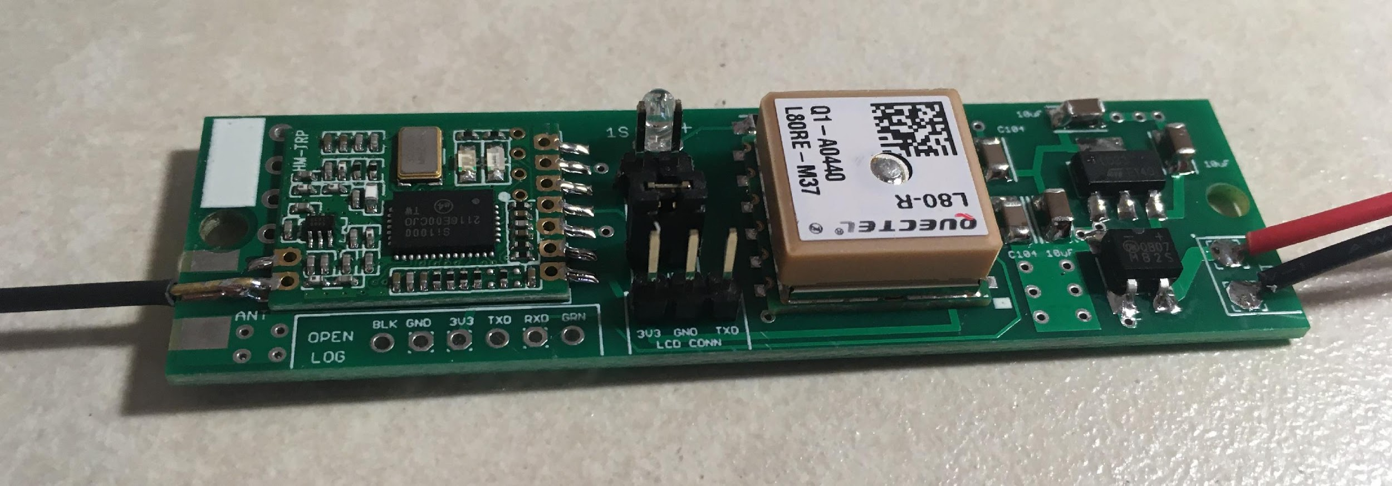
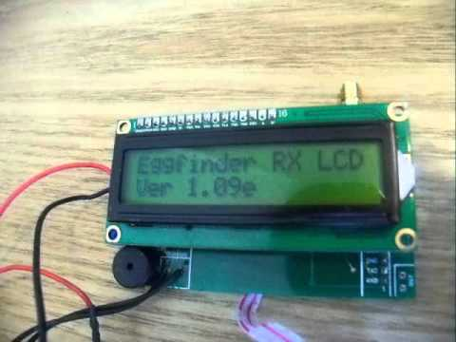
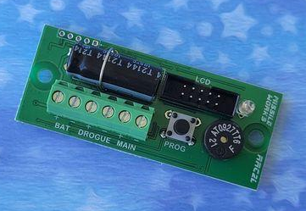
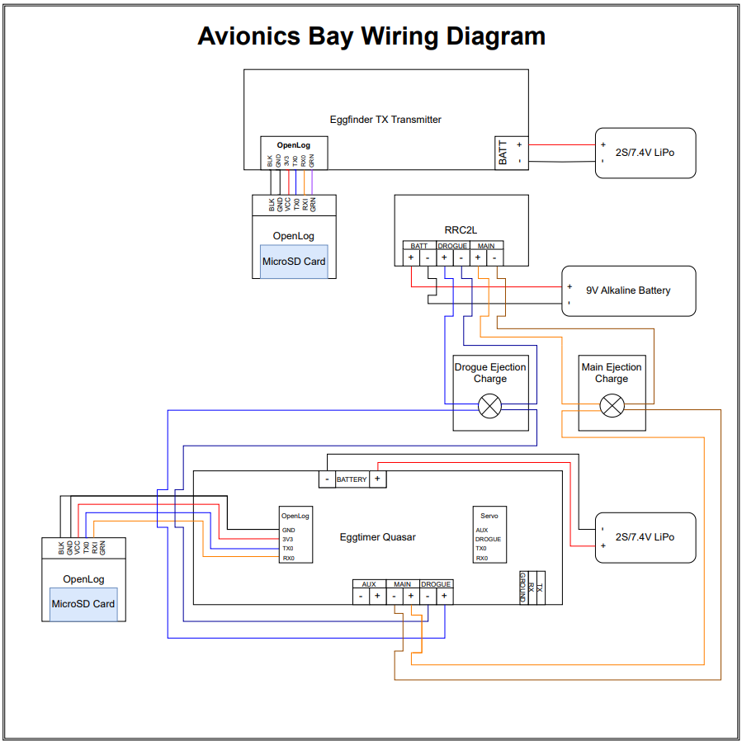
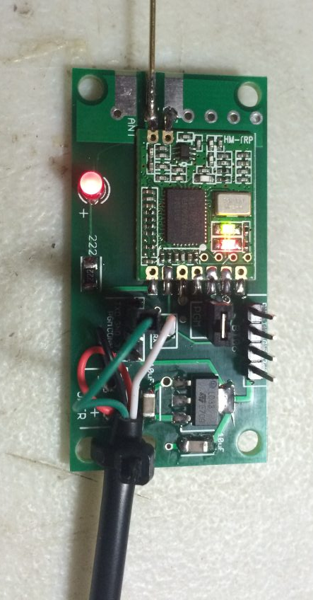
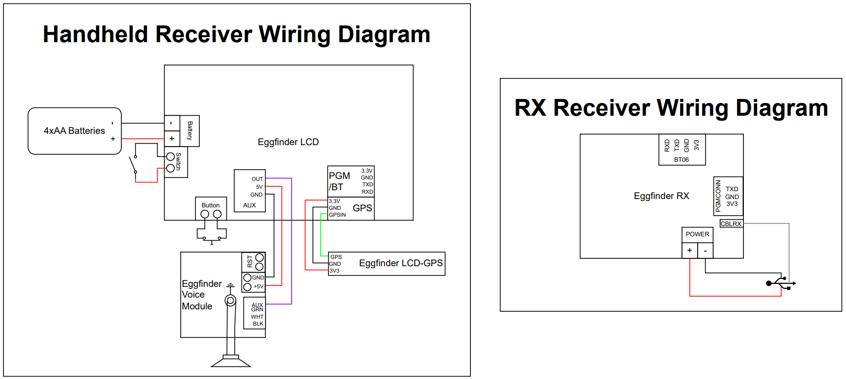
UNDERSTANDING AVIONICS
Eggfinder LCD Receiver
Eggtimer Quasar: Combination GPS and Altimeter
Eggfinder TX Transmitter: GPS
Avionics Bay
1 COTS Combination GPS and Altimeter
1 COTS Altimeter
1 COTS GPS
GPS devices connected to OpenLog
Static pressure hole in the bay
Ground Station
LCD Handheld Receiver
GPS Module
USB RX Receiver
MissileWorks RRC2L+
Eggfinder USB
RX Receiver

Slide 10
QUESTIONS?

